Slide 1

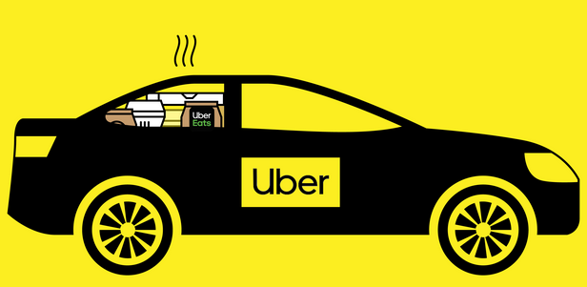
Uber: Applying Machine Learning to Improve the Customer Pickup Experience
ANANYA CANAKAPALLI
MANISHA VARMA
ROHITH ANIL NAIR
SAI KALYAN MAMILLAPALLI
SAURABH DAS NAIR
YASHASWINI BORE GOWDA

Slide 2
Pain Points and Customer Experience Mapping
Customer Experience | Contextualize | Assist | Depict | Navigate | Track | Meet
Riders | Inaccurate GPS contextualization led to the pickup location being slightly off, causing the rider to walk extra steps in discomfort. | GPS routing to a location the rider had no access to, causing confusion and the need for additional communication with the driver. | Incorrect depiction of the pickup location on the driver's app, leading to confusion and a phone call to coordinate. | Mismatched pickup locations, requiring the rider to cross a busy street, causing inconvenience and potential safety concerns. | Inaccurate tracking information and congestion affecting the driver's GPS location data, leading to frustration and canceled rides. | Congested rideshare pickup areas make it difficult for the rider to find the right car, causing delays and confusion.
Drivers | Drivers face frustration when the rider is not at the expected pickup location, leading to wasted time and potential low ratings. | Drivers experience delays and frustration due to unexpected traffic conditions caused by rerouting. | Drivers face challenges in avoiding distractions and potential safety hazards when making phone calls to coordinate pickups. | Drivers encounter difficulties in reaching the pickup location efficiently, leading to delays and potential safety issues. | Drivers face dissatisfaction and potential financial loss due to canceled rides and concerns about future cancellations. | Lack of information and congestion make it challenging for drivers to identify their riders efficiently, leading to delays and anxiety.

Slide 3
Ideal Pickup Experience for Each Driver Persona
Hobbyist Drivers: Flexible and satisfying experience despite lower usage volume.
UberX/Black Drivers (Specialized Vehicles): High-quality and professional service for premium riders.
Moto Drivers: Addressing scale issues for efficient service.
Regular Drivers (Driving for a Living):Maximizing efficiency to reduce wait times and fuel wastage.
Ideal Pickup Experience for Each Rider Persona
Frequent Riders (Commuters): Quick and reliable pickups for daily commuting needs.
Social Riders (Functions/Concerts):Timely pickups at busy venues during late hours.
Infrequent Uber Users (New Riders): Easy identification of pickup points and a seamless ride.

Slide 4
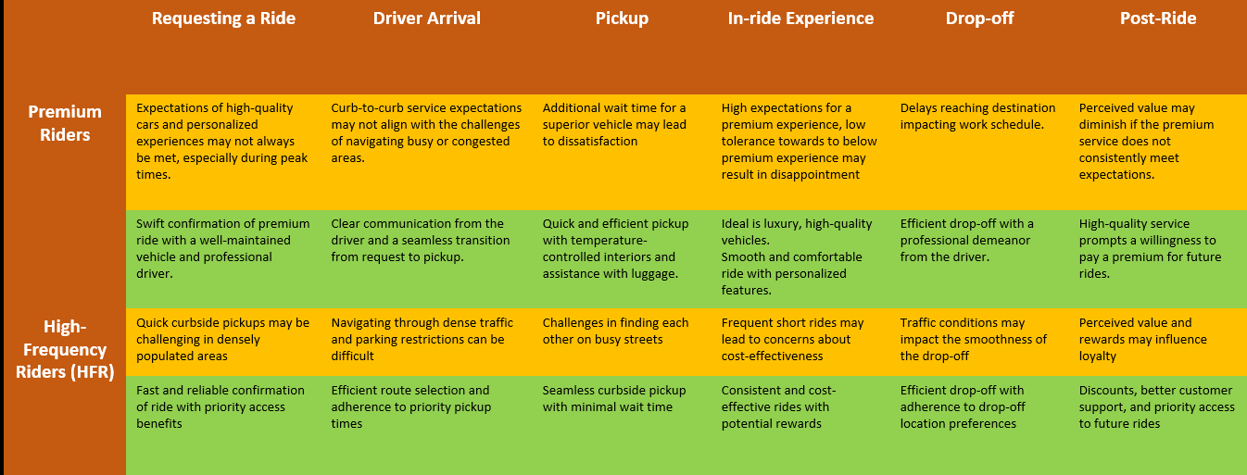
Personas and ideal pick up experience for riders

Slide 5
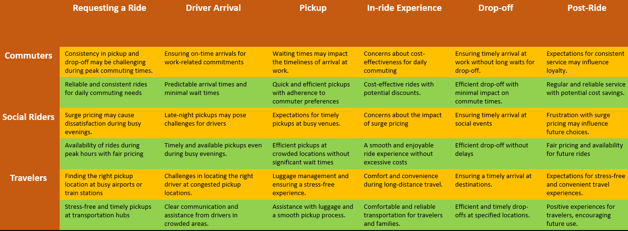

Slide 6
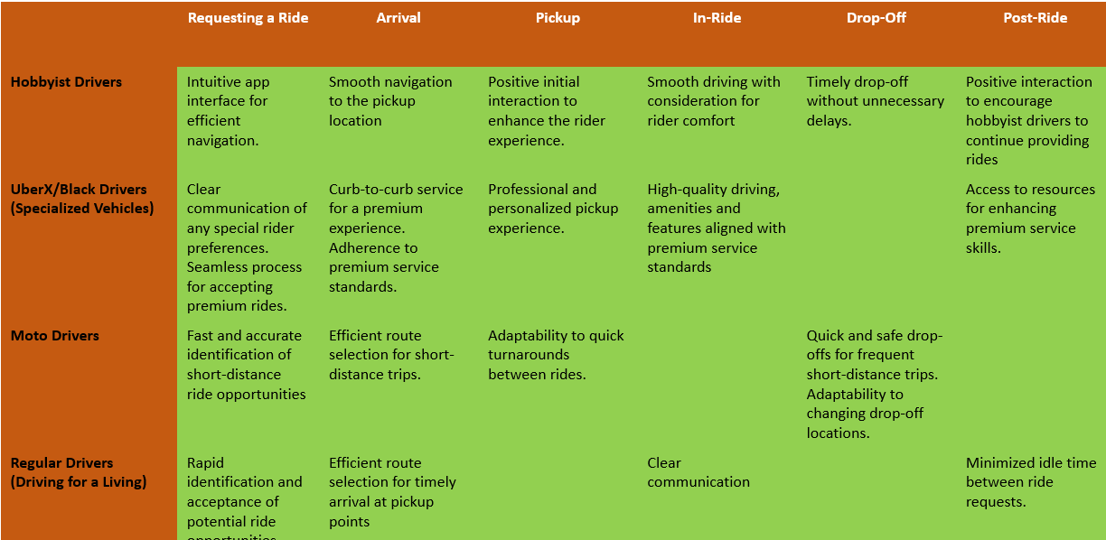
Personas and Ideal Pickup Experience for Drivers

Slide 7

A Hypothesis-Driven Approach for Enhancing Rider Pickup Location Prediction
HYPOTHESIS | EXPLANATION | EXAMPLE
Repeated Pickup Locations | Riders tend to request pickups from the same locations at specific times of the day or on specific days. By identifying locations that a rider has used multiple times, Uber can mark as likely pickup points, streamlining the prediction process. | Commuting to work in the morning at 9 a.m. and returning home in the evening at 5 p.m.
Match Singularities | GPS match percentages can help predict the rider’s pickup location accurately. | If the rider’s GPS data and cab location meet with a match of 80%, then rides can be rolled out.
Destination Influence | The destination entered by a rider may influence their pickup location. | If a particular destination frequently results in ride requests from a shopping mall, Uber can improve its accuracy of predicting the location.
Notes:
Hypothesis 1: By mapping the rider’s usage data, Uber can analyze recurring patterns in pickup locations.
Hypothesis 2: A GPS match percentage can help predict the pickup locations. When the rider and driver are in close proximity, a match score would be generated.
Hypothesis 3: Understanding the influence of a rider's destination on pickup locations allows Uber to anticipate common pickup points.

Slide 8
A Hypothesis-Driven Approach for Enhancing Rider Pickup Location Prediction
HYPOTHESIS | EXPLANATION | EXAMPLE
Data Pooling | Incorporating data from subsidiary data from services can be used in predictive modeling. | Uber Pool
Multidimensional Feedback Mechanism | A multidimensional feedback mechanism can be used where exact matches can be made. Multiple Regressions of real-time data can exactly map the driver with the rider. This ongoing analysis helps Uber continuously improve its predictions. | Real-time factors like traffic, time of day, and past behavior.
Weather Influence | Weather conditions can affect pickup locations, with more requests from indoor locations during bad weather. | During monsoon, users might prefer pickups from indoor locations or areas with shelter.
Recent Drop-off Indicator | If a rider was recently dropped off at a location, it was likely that they were requesting a ride nearby an hour later. | Restaurants, Event Venues
Notes:
Hypothesis 4: Uber Pool can directly impact the prediction of pickup locations. By pooling data from shared rides, Uber can refine predictions of pickup locations.
Hypothesis 5: Instead of considering just the distance between the rider and the driver, Uber can look at different real-time factors like traffic and time to make the best possible guess about where a rider will be.
Hypothesis 6: Impact of weather on pickup locations helps Uber adapt to changing user behavior. Such data can be used to predict pickup locations in the future.
Hypothesis 7: When a user requests for a ride, checking their recent drop-off location would predict that the user is most likely requesting a ride from the same place.

Slide 9
Proposed Pickup Quality Metric
Creating a quantitative pickup quality metric involves selecting relevant attributes and defining a scoring process.
Here's a proposed quantitative pickup quality metric using a combination of attributes derived from passive, active, and third-party signals available for Uber:
Proposed Pickup Quality Metric:
Pickup Quality Score = w1 * Normalized Distance Error + w2 * Number of ETA Changes + w3 * Time Spent in Search
Normalized Distance Error: Measures the deviation between the in-app rendezvous point and the actual pickup location.
Number of ETA Changes: Indicates how often the estimated time of arrival (ETA) changes during the pickup process.
Time Spent in Search: Measures the duration a rider or driver spends searching for each other.

Slide 10
Proposed Pickup Quality Metric: Parameters that can be used to enhance the experience
Driver Side
Rider Side
Third Party Signals
Driver Wait time – Active -15%
Distance Covered to meet the rider – Active-10%
Ease of Finding the location (Qualitative) – Passive-5%
Driver to deny duty if passenger score is low – Passive – 5%
Mapping of High ranked drivers to high-ranked riders- Active-5%
Steps required to meet the driver- Active-20%
Wait time to book a cab – Active-10%
Calls / Texts made to reach the location- Active-10%
Ease of Payments-Passive-5%
Rest 15% could be allocated to third-party signals like congestions or spending during commutes which can enhance tipping and additional revenue for riders
Congestion levels
GPS accuracy
Weather Conditions
Local events and holidays
Entertainment apps usage- Use of Value added services for the entertainment devices installed in the cars – Tie up opportunities with Netflix and Spotify

Slide 11
Suggested Actions to Improve the Pickup Experience
Specific pinpoint for areas with high-density pick-ups
Voice Commands
Frequently used locations
Leverage Telemetry data from cars to ensure optimal route
Live video blog feed
Qualitative measures
Congestion data from google maps API
Additional User Dissatisfiers like tickets should be resolved using semantics

Slide 12
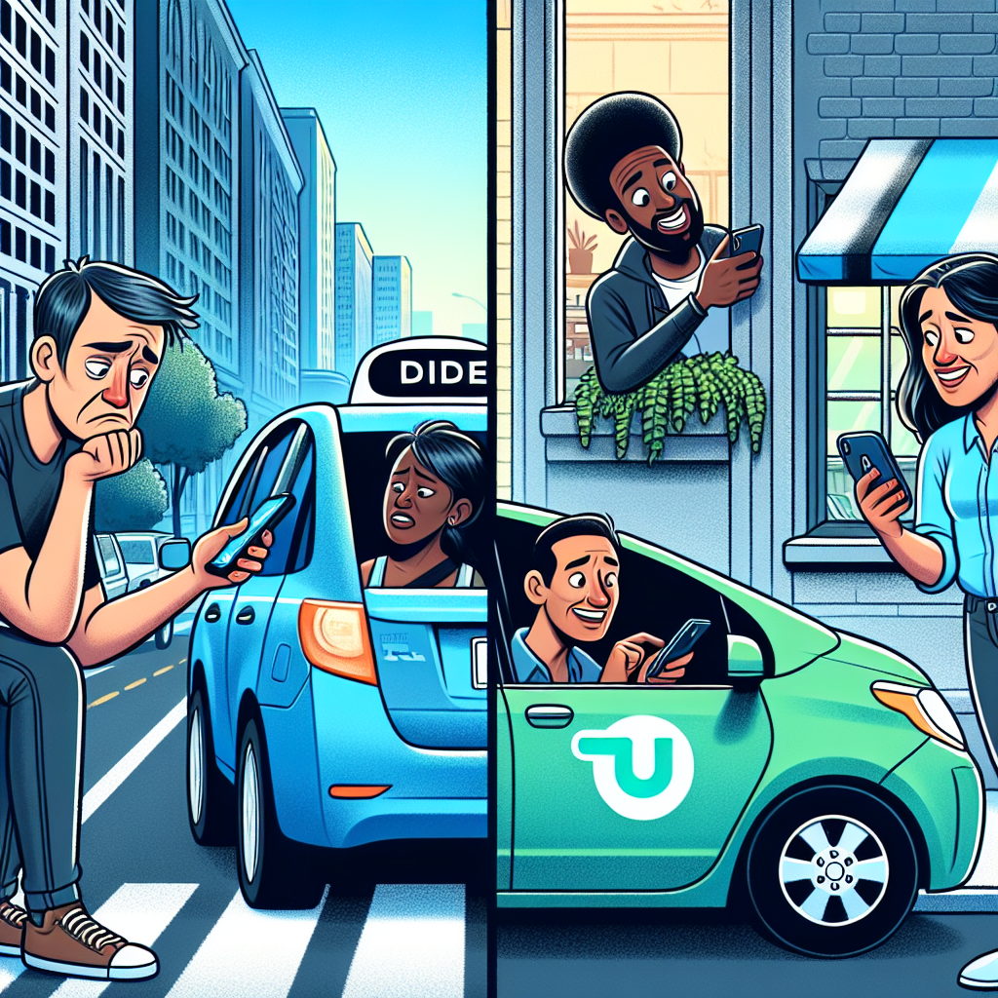
Revolutionizing Rider Pickups with Machine Learning
What is the business problem?
Why is it an important problem?
How will the solution benefit customers and the company?

Slide 13

Why do we need Machine Learning?
Flawed pickups have a direct impact on customer satisfaction, driver productivity, and overall business success. Optimizing pickups is not just a matter of convenience but a strategic move to enhance loyalty and profitability.
Machine learning is deemed appropriate for this business problem due to its ability to process complex, real-time data. With pickups depending on dynamic factors like traffic, events, and rider locations, machine learning can continuously adapt to these changing conditions.

Slide 14
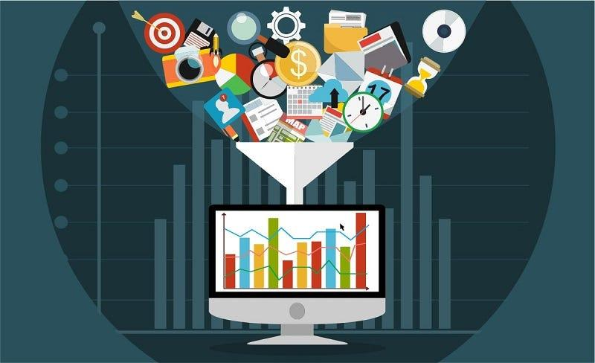
Data-Alchemy: Crafting the Perfect Pickup Experience
Utilize app interactions as building blocks for a well-crafted recipe.
Leverage proxy signals as clues guiding a better pickup.
Shape the Uber experience with customer feedback, ratings, and complaints.
Spice up the pickup experience with external data on traffic, weather, and events.

Slide 15
Preprocess the data & define features
Data in its raw form can contain errors which has to be removed to fit the requirements of the ml model.
Erroneous data due to GPS could be handled using historical data.
The objective function could be to minimize or maximize a defined heuristic value
Select machine learning approach & algorithm
Choose between supervised, unsupervised, or reinforcement learning.
Assess different algorithms.
Choose best performing algorithms.

Slide 16
Engineer features & improve model
Brainstorm possible features
Select the set of features that will maximize the accuracy of the model.
Use ensemble methods to improve model performance
Make decisions & design user experience
Trigger UX messages to customers
Trigger messages to employees or partners
Automatically update UI dashboards based on model outputs

